Slide 1
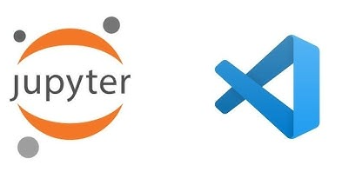
Beyond the Basic Script
The Ecosystem: Moving from standalone Python scripts to integrated environments like Jupyter Lab, VS Code Notebooks, and Google Colab.
Why it matters: These tools allow for "Literate Programming"—mixing live code, equations, and rich text in one place.
Cloud vs. Local: Using Colab for free GPU/TPU access versus VS Code for heavy local development.

Slide 2
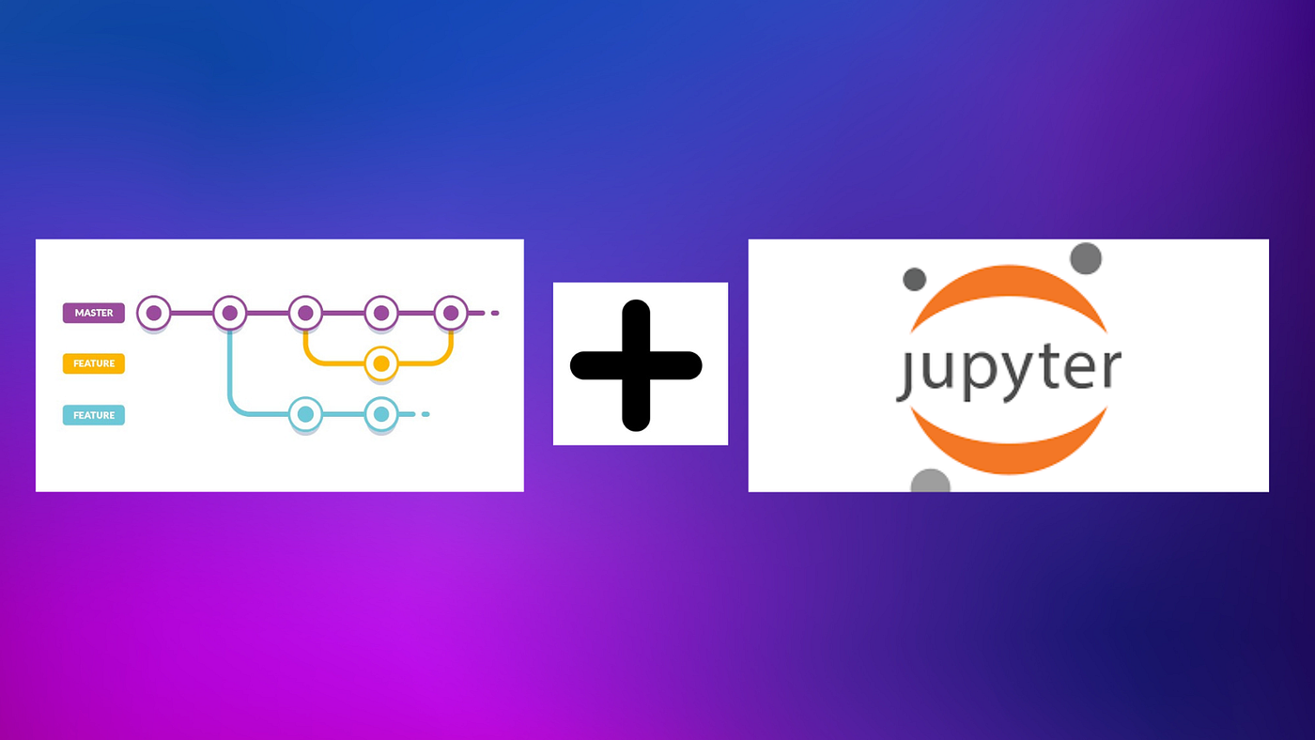
The Version Control Crisis (nbdime)
The Problem: Notebooks are stored as complex JSON files. Standard Git "diffs" are unreadable, showing metadata changes instead of code changes.
The Solution: nbdime (Notebook Diffing and Merging).
Capability: It allows you to see exactly which code cell or image changed without the "JSON noise".

Slide 3
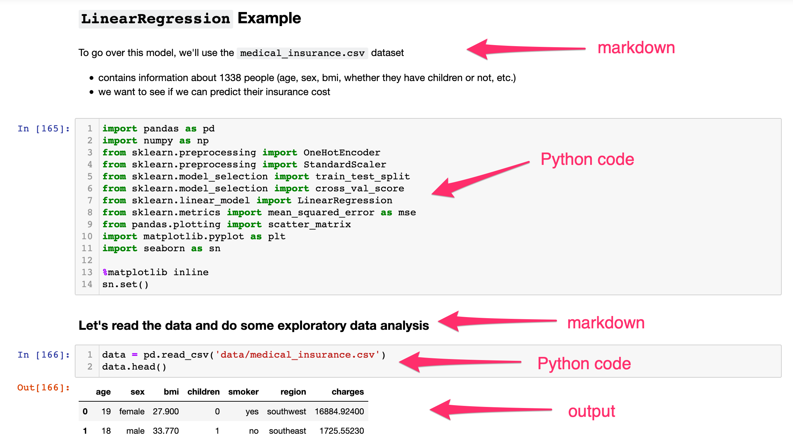
Bridging the "Technical Gap" with Markdown
Stakeholder Communication: Non-technical managers don't want to read code; they want to read insights.
Markdown's Role: Using headers, bold text, and LaTeX to turn a technical notebook into a professional business report.
Executive Summaries: Every professional notebook should start with a Markdown cell explaining the "Why" and the "Result".

Slide 4
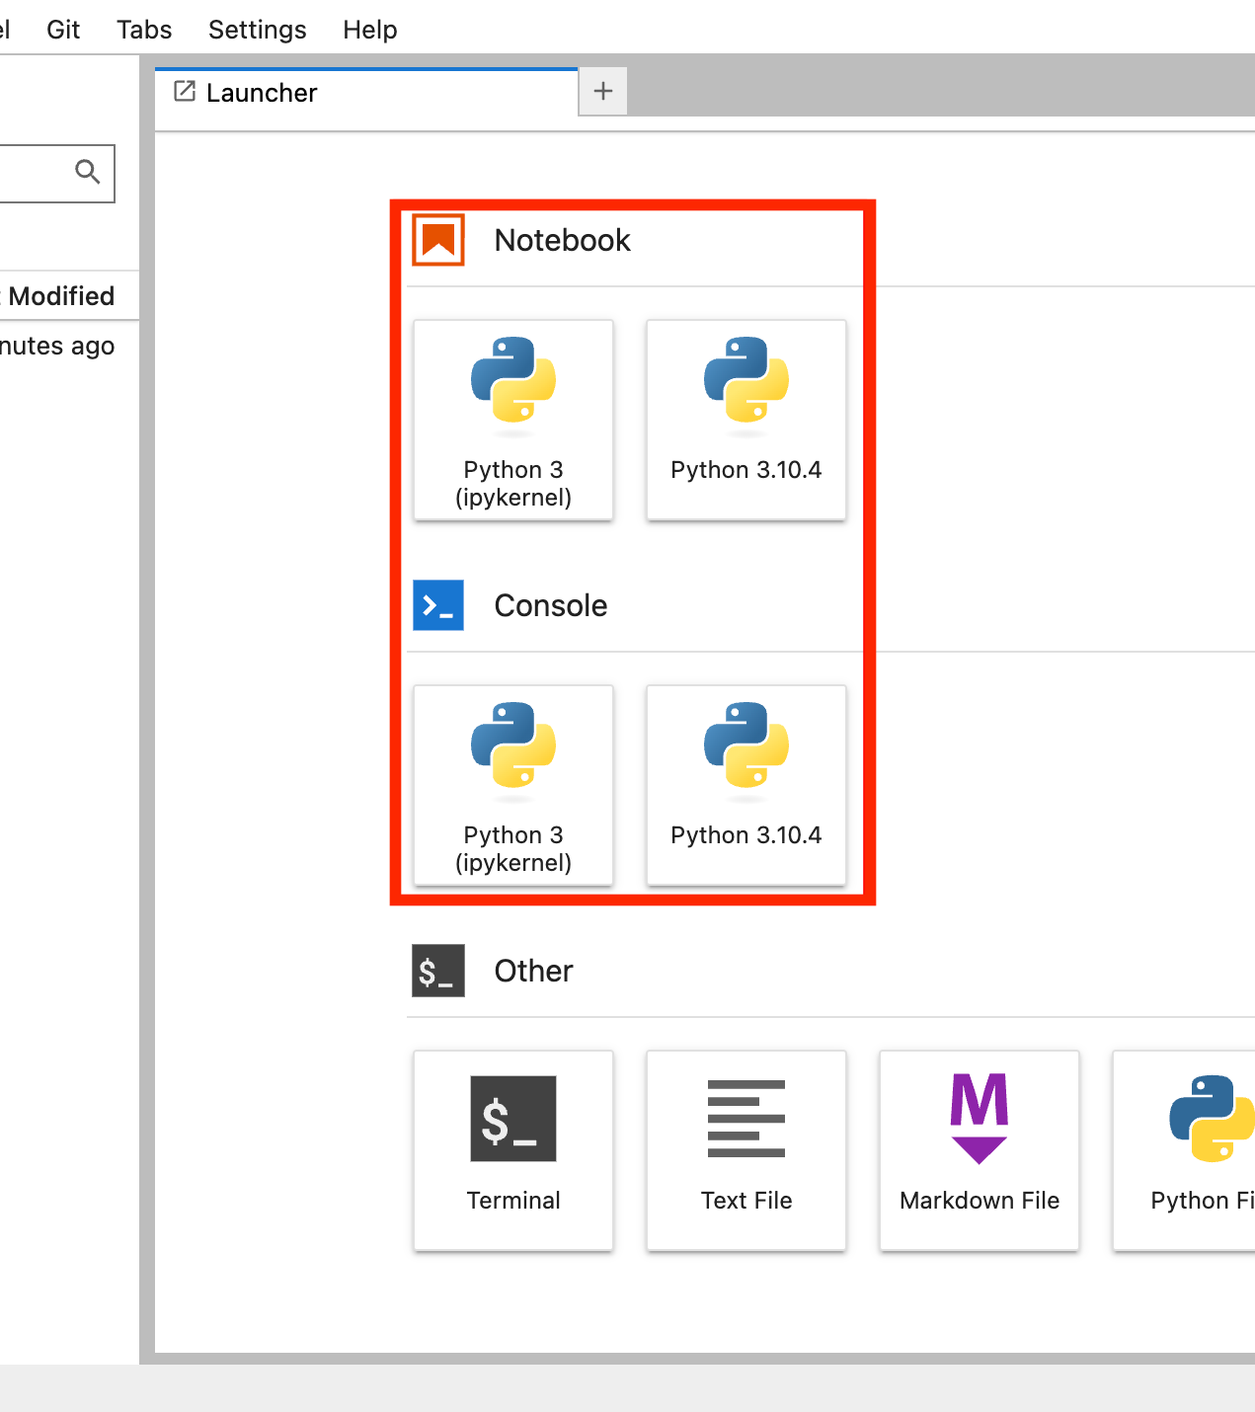
Kernel Management & Reproducibility
The "Kernel" Concept: The engine that executes your code.
Version Control: Understanding how to switch between Python 3.8 and Python 3.11 inside the same interface to avoid library conflicts.
Environment Isolation: Ensuring that your "Agricultural" project doesn't break your "Healthcare" project by using separate kernels.

